Slide 1

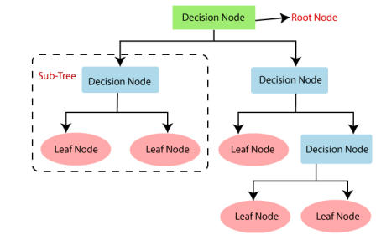
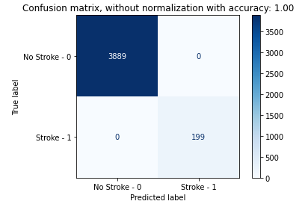
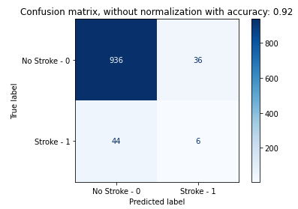
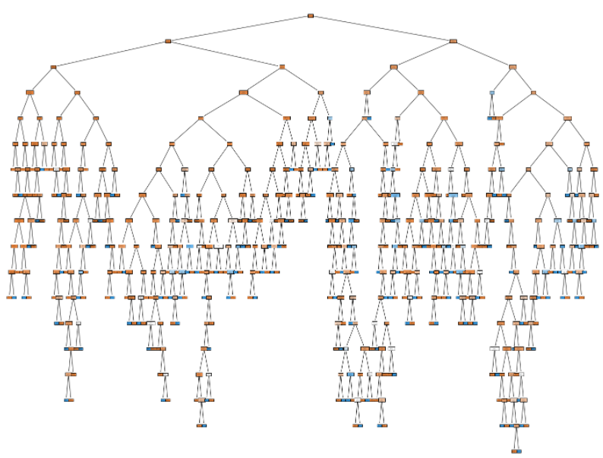
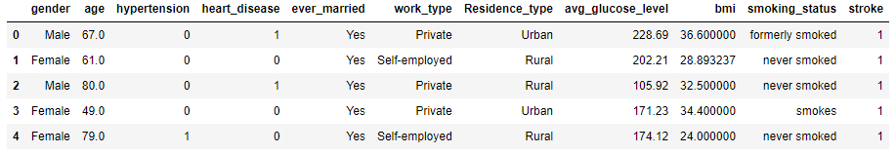
Computer Science Department
Final Project: Predicting Stroke Risk
Course: Introduction to AI (CS156)
Course Instructor: Yulia Newton, Ph.D.
Andrew Vu
Introduction/Background
Methodology
Analysis and Results
Summary/Conclusions
The problem that I will be solving is predicting whether a patient would likely receive a stroke based on certain factors. A stroke can occur when blood supply to the brain is blocked, or blood vessels in the brain burst, which can lead to brain damage, disability, or death. It’s interesting to me because I’m not particularly familiar with strokes and their risks, so it would be helpful to know about.
This problem is particularly important to solve since strokes are the 2nd leading cause of death in the world. With such a popular cause of death, the problem naturally has been investigated many times. By evaluating factors like gender, age, and smoking history, the goal of the project would be to predict whether a patient would potentially have a stroke or not.
Algorithm/Model
I used a decision tree machine learning model to complete this project. A decision tree is a hierarchical tree which can be traversed to make a decision, where each “node” of the tree is a decision that can split into different “sub-nodes.”
I decided to use a decision tree to predict stroke risk because decision trees work well in making complex decisions, and stroke risk can be a very complex problem with various deciding factors. It also can produce simpler models, which make understanding the process of machine learning algorithms much easier.
Validation/cross-validation results
Across 5 folds of cross-validation, the model averaged about 91% accuracy in stroke risk prediction. With a real validation set or more entries of data, this value could have potentially been higher.
Overall, the results of my project definitely could have improvements. The problem at hand isn’t necessarily a difficult one to predict, as it’s a binary classification problem. Comparing this to other datasets that I’ve used in the past, 91% cross-validation accuracy and 92% test data accuracy isn’t nearly as high of a value as it can be. That being said, there aren’t many improvements that would significantly change the results of the project.
Using a different model such as a perceptron model, I found that the cross-validation and test accuracies were slightly higher values. However, I felt that the use of a perceptron model didn’t fit the scope of the problem as well as the use of a decision tree model, since decision tree models are more recognized for making decisions and predictions than perceptron models.
Given more time, I would like to investigate the possibility of how much each independent variable contributes to the risk of having a stroke. For example, I would want to know how much marriage status truly matters compared to another independent variable like age. I could showcase this in a graph or a table of values corresponding to each independent variable.
Figure 4: Cross-validation results from decision tree model
Training results
Training data accuracy was 100% after fitting the decision tree model.
Dataset description
The dataset that I used to predict stroke risk is the “Stroke Prediction Dataset” from Kaggle’s datasets (https://www.kaggle.com/datasets/fedesoriano/stroke-prediction-dataset).
The independent variables that I will be using to train my model are: gender, marriage status, work type, residence type (categorical variables), and age, hypertension, heart disease, average glucose level, BMI (numeric variables). The training data represents the factors and features that impact the decision of whether a patient would have a stroke or not. This dataset has 10 features with 5110 observations/data points.
The dependent variable is a numeric variable that returns a 1 if the patient had a stroke, or a 0 if the patient did not have a stroke. This variable is the value that the model aims to predict and suggests that this problem is a classification problem.
I used Scikit-learn’s train_test_split function to split my data at an 80/20 ratio. I used a cross-validation approach and stratified my data split since the data is organized first through people who’ve had strokes and then people who have not.
Figure 2: An example of a decision tree in machine learning. Source: https://addepto.com/decision-tree-machine-learning-model/
Figure 5: Confusion matrix of training results on decision tree model, where the top-left and bottom-right numbers represent the correct predictions
Key References
[1] Haponik, A. (2022, April 22). Decision tree machine learning model. Addepto. Retrieved May 15, 2022, from https://addepto.com/decision-tree-machine-learning-model/
Application to the project
After fitting the decision tree model to the training data, I was able to plot a large decision tree to visualize the hundreds of decisions that the model has to make in order to predict stroke risk.
Test results
Test data accuracy was 92% after fitting the decision tree model.
Acknowledgements
I would like to thank my parents and sisters for believing in me and encouraging me to do my best, as well as Professor Newton for being an amazing teacher.
Figure 6: Confusion matrix of test results on decision tree model, where the top-left and bottom-right numbers represent the correct predictions
Figure 1: Five of the 5110 entries in the dataset
Figure 3: Decision tree plot after fitting model

